Slide 1
VIRTUAL BUDDY APPS : CHAT MANAGEMENT SYSTEM FOR UITM STAFF USING PROGRESSIVE WEB APPLICATION
PRESENT BY :WAN PUTERA NUR SYAFIQ BIN WAN JEFERI (2020836988)
SUPERVISOR :ASSOC.PROF.DR.SURIYANI BINTI ARIFFIN

Slide 2


PROBLEM STATEMENT
CYBERBULLYING
SPREAD OF FAKE NEWS
Cyberbullying has a significant impact on the physical and emotional health of those who are subjected to it (Zych, Baldry, Farrington & Llorent,2018)
University students are readily misleading and led to Fake News, which they easily disseminate (Herman, 2017).

Slide 3
AIM AND OBJECTIVE
Suitable features
that can be included
in the proposed web
base application
TO IDENTIFY
TO DEVELOP
TO EVALUATE
1
2
3
Web base application to assist UiTM staff in managing student chat activities in Virtual Buddy Apps
The functionality of the developed web base application

Slide 4
SCOPE
Developed for UiTM staff
Progressive Web Application (PWA)
Add, remove, block, unblock, view ,search and print
TARGET USER
METHOD
FEATURE

Slide 5
SIGNIFICANCE
UiTM Staff
UiTM Staff
UiTM Staff
Easy to monitor student chat activities
Easy to remove student access
Easy to monitor chat rooms.

Slide 6
LITERATURE REVIEW

Slide 7
VIRTUAL BUDDY | CHAT MANAGEMENT SYSTEM | PROGRESSIVE WEB APPLICATION
A virtual buddy, also known as a virtual friend is an online friend. A virtual buddy is typically a real person who may be invited to speak or play game with (Betts,2019). | The chat management system will keep track of all the conversations that are taking place and will be able to detect any suspicious chat (ladychampionz,2020) | Progressive Web Application include feature such as push notifications nad the ability to work offline(Nyakundi,2021)

Slide 8

COMPARISON OF SIMILAR SYSTEM
 | PROGRESSIVE WEB APPLICATION (PWA) | USER BANS | LIVE CHAT WITH USER | CUSTOM EMOJI | CHAT LOGS
Instamobile: Chat App Admin Panel
ArrowChat: Admin
FEATURE
SYSTEM
x
x
x
x
x

Slide 9
METHODOLOGY

Slide 10
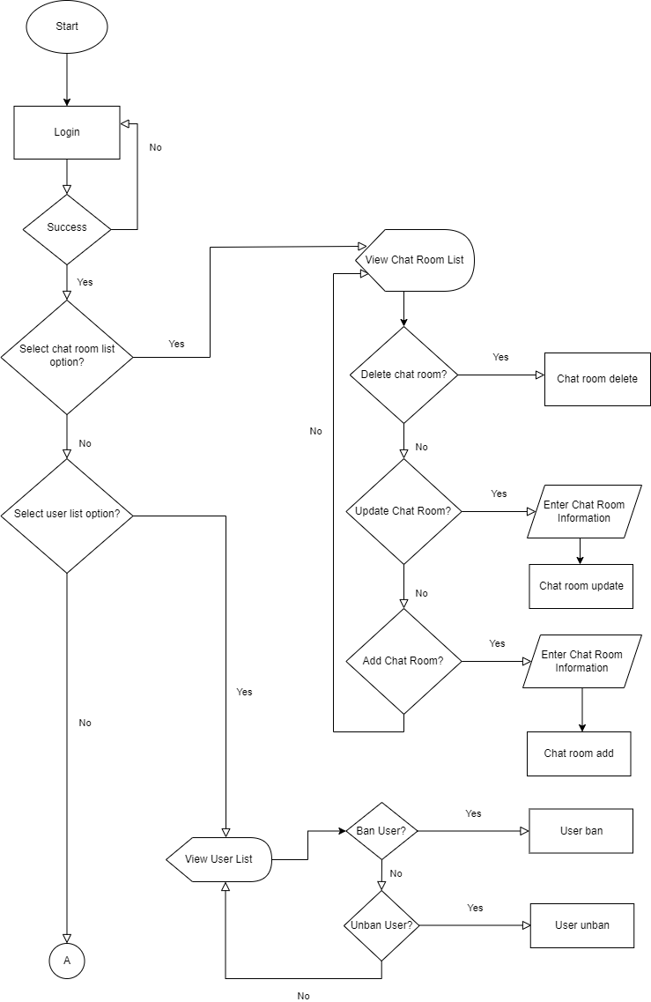
SYSTEM DESIGN
FLOWCHART

Slide 11
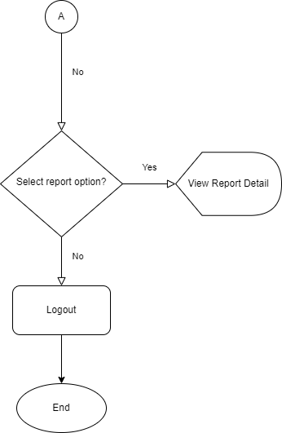
SYSTEM DESIGN
FLOWCHART

Slide 12
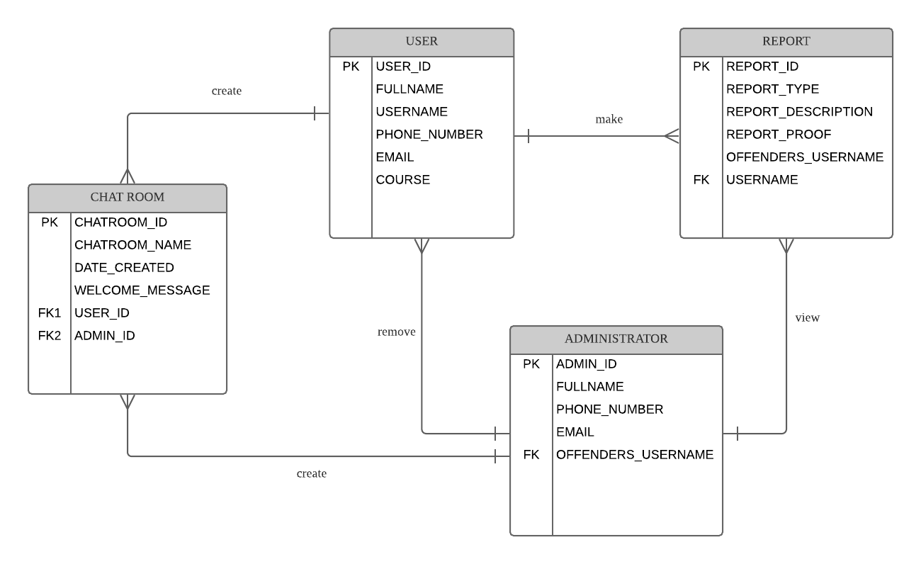
SYSTEM DESIGN
ENTITY RELATIONSHIP DIAGRAM

Slide 13
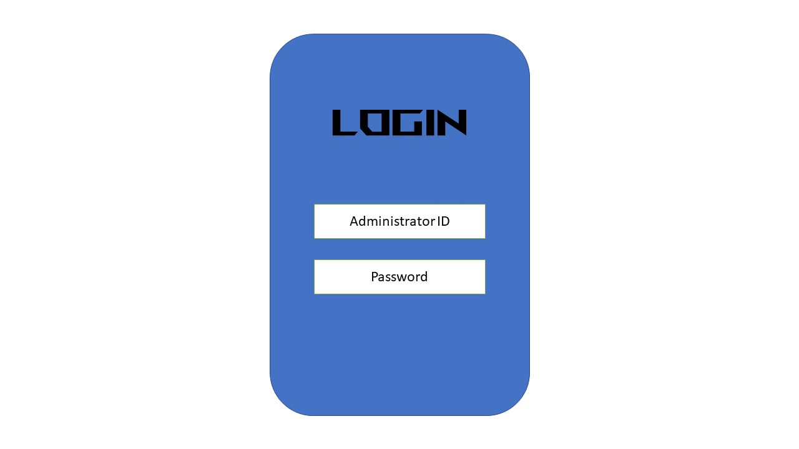
SYSTEM DESIGN
USER INTERFACE

Slide 14
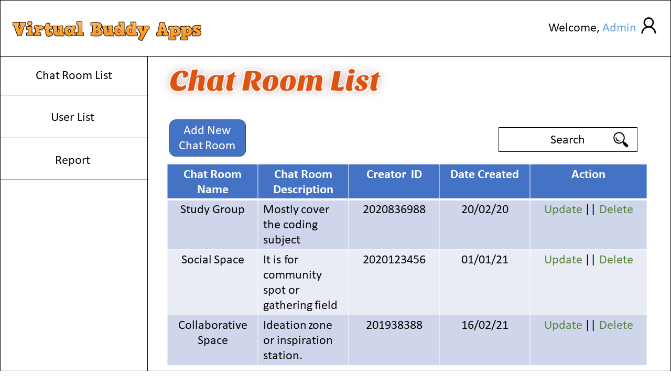
SYSTEM DESIGN
USER INTERFACE

Slide 15
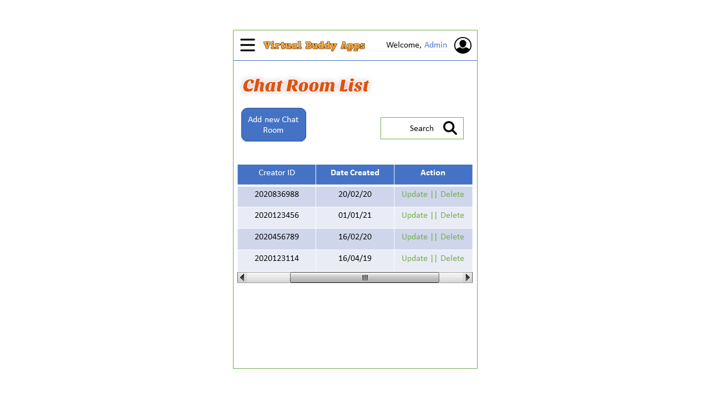
SYSTEM DESIGN
USER INTERFACE

Slide 16
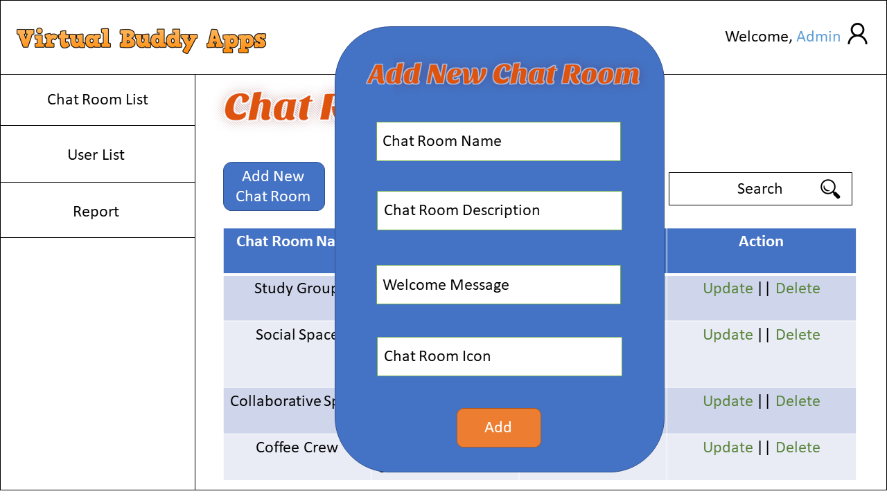
SYSTEM DESIGN
USER INTERFACE

Slide 17
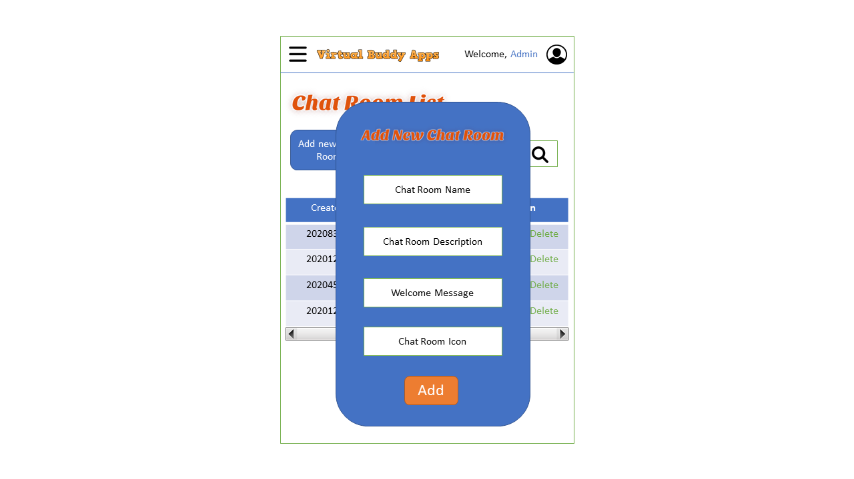
SYSTEM DESIGN
USER INTERFACE

Slide 18
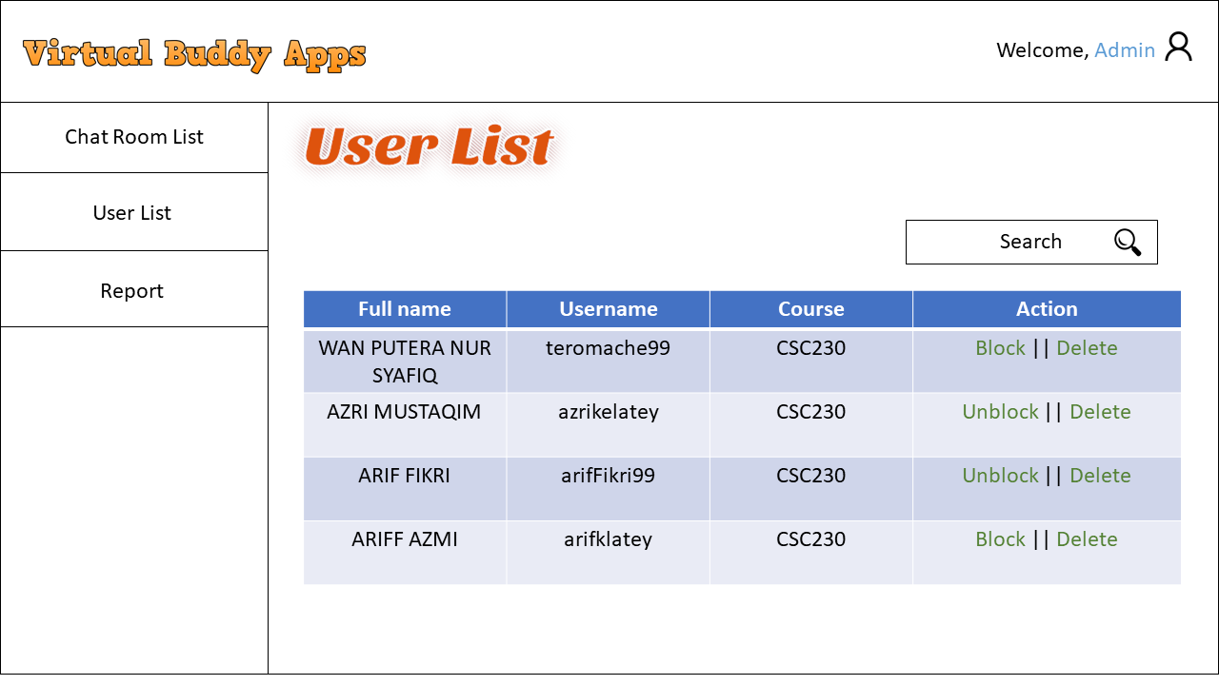
SYSTEM DESIGN
USER INTERFACE

Slide 19
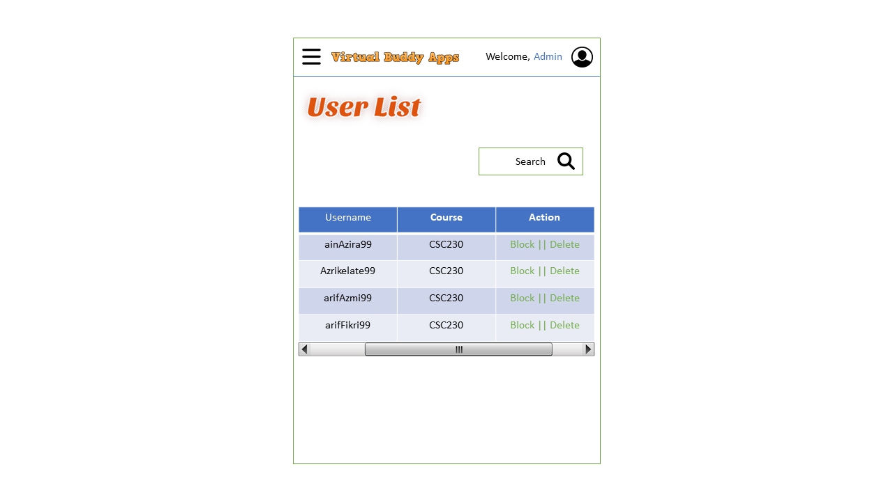
SYSTEM DESIGN
USER INTERFACE

Slide 20
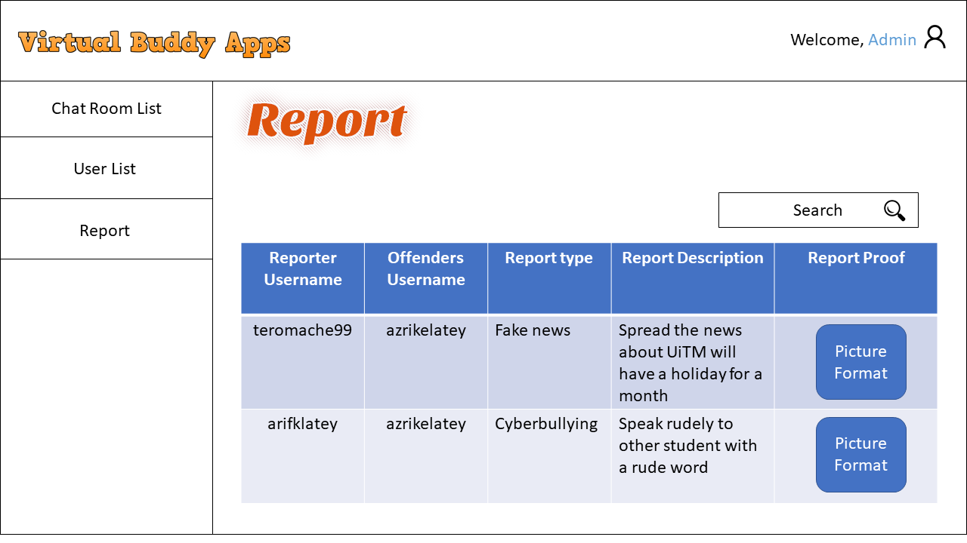
SYSTEM DESIGN
USER INTERFACE

Slide 21
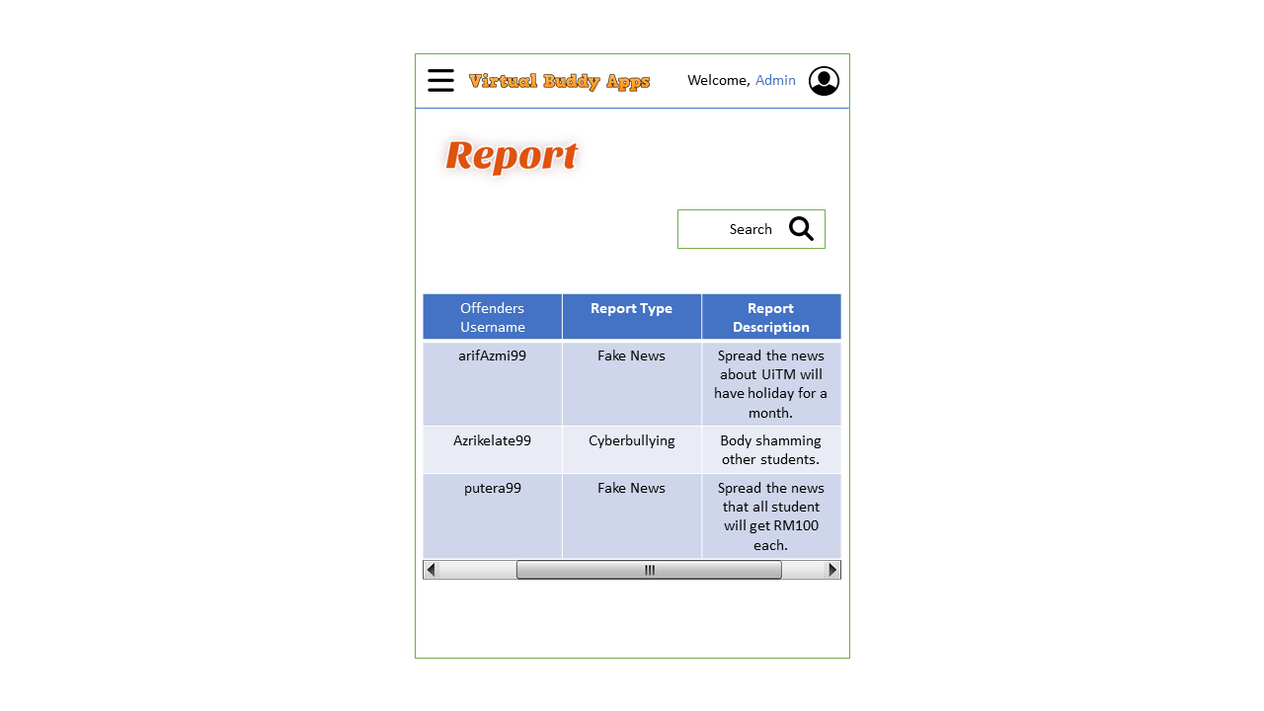
SYSTEM DESIGN
USER INTERFACE

